Slide 1
Security
Lecture 2

Slide 2


Main Topics
1. Overview of Cryptography.
2. Mathematics Background.
3. Number-Theoretic Reference Problems.
4. Public-Key Parameters.
5. Pseudorandom Bits and Sequences.
6. Stream Ciphers.
7. Block Ciphers.
8. Public-Key Encryption.
9. Hash Functions and Data Integrity.
10. Identification and Entity Authentication.
11. Digital Signatures · Key Establishment Protocols.
12. Key Management Techniques.
13. Efficient Implementation.
14. Patents and Standards.

Slide 3
Classical Encryption Techniques
Part 1
2-1 Encryption Techniques
2-2 Symmetric Cipher Model
2-3 Substitution Techniques
2-4 Transposition Techniques
2-5 Rotor Machines
2-6 Steganography

Slide 4
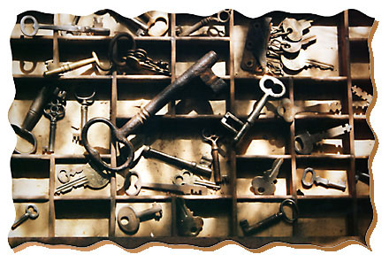
2-1 Encryption Techniques

Slide 5
Cryptography
cryptographic system is characterized by:
type of encryption operations used
number of keys used
way in which plaintext is processed
Notes:
Cryptographic systems can be characterized along these three independent dimensions.

Slide 6
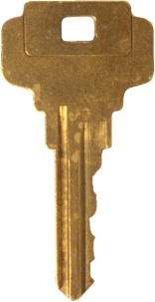
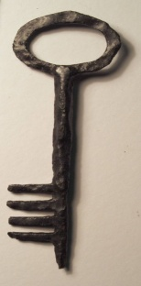
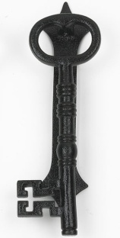
Encryption Techniques
According to the no. of keys used
Symmetric Encryption
Asymmetric Encryption
(public-key encryption)
The same key is used to encrypt and decrypt
System uses two keys;
a public key known to everyone and a private or secret key known only to the recipient of the message.

Slide 7
Encryption Techniques
According to the type of encryption operations used
Substitution
Encryption
Transposition
Encryption
Product
Encryption

Slide 8
Encryption Techniques
According to the way in which plaindata is processed
Stream Ciphers
Block Ciphers
Synchronous
Asynchronous
Classical
Modern
DES
AES
Stream ciphers encrypt the bytes of the message one at a time
block ciphers take a number of bytes and encrypt them as a single unit. Blocks of 64 bits have been commonly used;

Slide 9
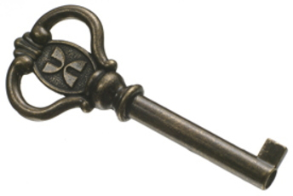
2-2 Symmetric Cipher Model
The same key is used to encrypt and decrypt

Slide 10
Some Basic Terminology
plaintext - original message
ciphertext - coded message
cipher - algorithm for transforming plaintext to ciphertext
key - info used in cipher known only to sender/receiver
encipher (encrypt) - converting plaintext to ciphertext
decipher (decrypt) - recovering plaintext from ciphertext
cryptography - study of encryption principles/methods
cryptanalysis (codebreaking) - study of principles/ methods of deciphering ciphertext without knowing key
cryptology - field of both cryptography and cryptanalysis
Notes:
Briefly review some terminology used throughout the course.

Slide 11
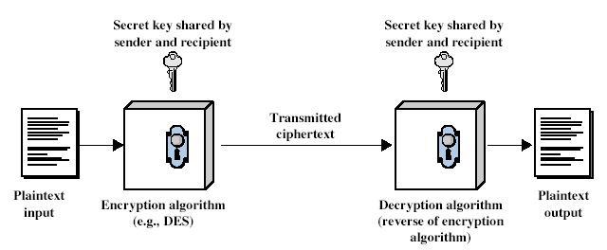
Symmetric Cipher Model
Notes:
Detail the five ingredients of the symmetric cipher model, shown in Stallings Figure 2.1:
plaintext - original message
encryption algorithm – performs substitutions/transformations on plaintext
secret key – control exact substitutions/transformations used in encryption algorithm
ciphertext - scrambled message
decryption algorithm – inverse of encryption algorithm

Slide 12
Requirements
two requirements for secure use of symmetric encryption:
a strong encryption algorithm
a secret key known only to sender / receiver
mathematically have:
Y = E (K,X)
X = D (K,Y)
assume encryption algorithm is known
implies a secure channel to distribute key
Notes:
We assume that it is impractical to decrypt a message on the basis of the cipher- text plus knowledge of the encryption/decryption algorithm, and do not need to keep the algorithm secret; rather we only need to keep the key secret. This feature of symmetric encryption is what makes it feasible for widespread use. It allows easy distribution of s/w and h/w implementations.
Can take a closer look at the essential elements of a symmetric encryption scheme: mathematically it can be considered a pair of functions with: plaintext X, ciphertext Y, key K, encryption algorithm E_{K}, decryption algorithm D_{K}.

Slide 13
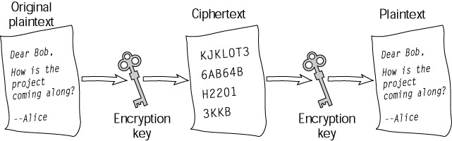
Model of Conventional Cryptosystem
Cryptanalyst
X
K
X = D (K,Y)
Message
Source
X
Encryption
Algorithm
Y
Decryption
Algorithm
X
Destination
Y = E (K,X)
Secure Channel
K
Key
Source

Slide 14
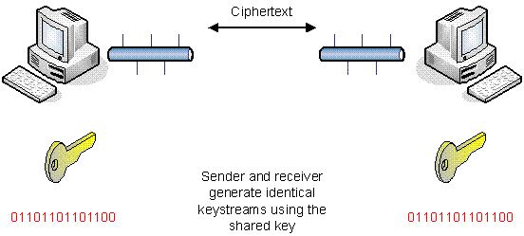
Example; on Stream Ciphers
A stream cipher is a symmetric (secret key) cipher that operates on small units of data (as small as a single bit) at a time.
Sender and receiver both share the secret key
To send a message the sender uses the key to produce an infinite pseudo-random keystream. The keystream is then logically combined with the plaintext, typically via an operation such as XOR to produce ciphertext.
At the other end of the network, the receiver uses the shared secret key to produce an identical keystream to the sender. This is then XOR-ed with the incoming ciphertext to reproduce the original plaintext.

Slide 15
Brute Force Search
always possible to simply try every key
most basic attack, proportional to key size
assume either know / recognise plaintext
Key Size (bits) | Number of Alternative Keys | Time required at 1 decryption/µs | Time required at 10⁶ decryptions/µs
32 | 2³² = 4.3 × 10⁹ | 2³¹ µs = 35.8 minutes | 2.15 milliseconds
56 | 2⁵⁶ = 7.2 × 10¹⁶ | 2⁵⁵ µs = 1142 years | 10.01 hours
128 | 2¹²⁸ = 3.4 × 10³⁸ | 2¹²⁷ µs = 5.4 × 10²⁴ years | 5.4 × 10¹⁸ years
168 | 2¹⁶⁸ = 3.7 × 10⁵⁰ | 2¹⁶⁷ µs = 5.9 × 10³⁶ years | 5.9 × 10³⁰ years
26 characters (permutation) | 26! = 4 × 10²⁶ | 2 × 10²⁶ µs = 6.4 × 10¹² years | 6.4 × 10⁶ years
Notes:
A brute-force attack involves trying every possible key until an intelligible translation of the ciphertext into plaintext is obtained. On average, half of all possible keys must be tried to achieve success. Stallings Table 2.2 shows how much time is required to conduct a brute-force attack, for various common key sizes (DES is 56, AES is 128, Triple-DES is 168, plus general mono-alphabetic cipher), where either a single system or a million parallel systems, are used.

Slide 16
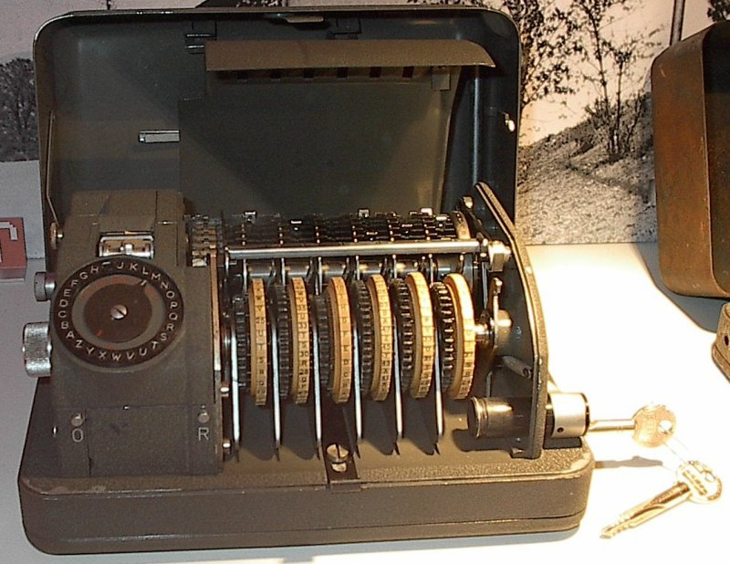
2-3 Substitution Techniques

Slide 17
Encryption Techniques
According to the type of encryption operations used
Substitution
Encryption
Transposition
Encryption
Product
Encryption

Slide 18
Classical Substitution Ciphers
where letters of plaintext are replaced by other letters or by numbers or symbols
or if plaintext is viewed as a sequence of bits, then substitution involves replacing plaintext bit patterns with ciphertext bit patterns
Notes:
In this section and the next, we examine a sampling of what might be called classical encryption techniques. A study of these techniques enables us to illustrate the basic approaches to symmetric encryption used today and the types of cryptanalytic attacks that must be anticipated. The two basic building blocks of all encryption technique are substitution and transposition. We examine these in the next two sections. Finally, we discuss a system that combine both substitution and transposition.

Slide 19
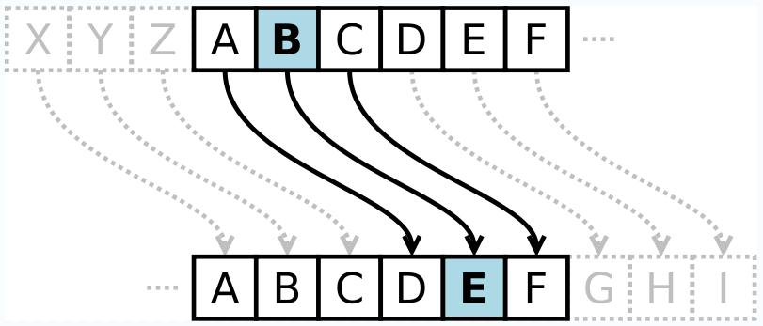
Caesar Cipher
earliest known substitution cipher
by Julius Caesar
first attested use in military affairs
replaces each letter by 3rd letter on
example:
meet me after the toga party
PHHW PH DIWHU WKH WRJD SDUWB
Notes:
Substitution ciphers form the first of the fundamental building blocks. The core idea is to replace one basic unit (letter/byte) with another. Whilst the early Greeks described several substitution ciphers, the first attested use in military affairs of one was by Julius Caesar, described by him in Gallic Wars (cf. Kahn pp83-84). Still call any cipher using a simple letter shift a caesar cipher, not just those with shift 3.

Slide 20
Caesar Cipher
can define transformation as:
a b c d e f g h i j k l m n o p q r s t u v w x y z
D E F G H I J K L M N O P Q R S T U V W X Y Z A B C
mathematically give each letter a number
a b c d e f g h i j k l m n o p q r s t u v w x y z
0 1 2 3 4 5 6 7 8 9 10 11 12 13 14 15 16 17 18 19 20 21 22 23 24 25
then have Caesar cipher as:
c = E(p) = (p + k) mod (26)
p = D(c) = (c – k) mod (26)
Notes:
This mathematical description uses modulo (clock) arithmetic. Here, when you reach Z you go back to A and start again. Mod 26 implies that when you reach 26, you use 0 instead (ie the letter after Z, or 25 + 1 goes to A or 0).
Example: howdy (7,14,22,3,24) encrypted using key f (ie a shift of 5) is MTBID

Slide 21
Examples on Modulo 26 Addition
c = E(p) = (p + k) mod (26)
p = D(c) = (c – k) mod (26)
define modulo operator “a mod n” to be remainder when a is divided by n
(5+7) mod (26) =
12
(9+12) mod (26) =
21
(15+17) mod (26) = (32) mod (26) =
6
(14+12) mod (26) = (26) mod (26) =
0
(15-11) mod (26) = (4) mod (26) =
4
(15-18) mod (26) = (-3) mod (26) =
23

Slide 22
Example on Caesar Cipher
Key: K = 3
Algorithm: SR
F+3 = I I+3 = L
FIRE MISSILE
ILUH PLVVLOH
Blocks of length 5
ILUHP LVVLO H
W X Y Z | …….. | A B C D | Plaintext Letter
Z A B C | …….. | D E F G | Ciphertext Letter
Notes:
This mathematical description uses modulo (clock) arithmetic. Here, when you reach Z you go back to A and start again. Mod 26 implies that when you reach 26, you use 0 instead (ie the letter after Z, or 25 + 1 goes to A or 0).
Example: howdy (7,14,22,3,24) encrypted using key f (ie a shift of 5) is MTBID

Slide 23
Cryptanalysis of Caesar Cipher
only have 26 possible ciphers
A maps to A,B,..Z
could simply try each in turn
a brute force search
given ciphertext, just try all shifts of letters
do need to recognize when have plaintext
eg. break ciphertext "GCUA VQ DTGCM"
Notes:
With a caesar cipher, there are only 26 possible keys, of which only 25 are of any use, since mapping A to A etc doesn't really obscure the message! Note this basic rule of cryptanalysis "check to ensure the cipher operator hasn't goofed and sent a plaintext message by mistake"!
Can try each of the keys (shifts) in turn, until can recognise the original message. See Stallings Fig 2.3 for example of search.
Note: as mentioned before, do need to be able to recognise when have an original message (ie is it English or whatever). Usually easy for humans, hard for computers. Though if using say compressed data could be much harder.
Example "GCUA VQ DTGCM" when broken gives "easy to break", with a shift of 2 (key C).

Slide 24
HW on Caesar Ciphers
Caesar Cipher: all letters shifted 5 along such that an "f" in the plaintext would become an "a" in ciphertext (and likewise plaintext g –-> ciphertext b) RCTY JZNG JQZC VQZO JWZG DFZV WVOO GZAD ZGY Decode the above and encode the word "pixie" using the same Caesar cipher

Slide 25
Monoalphabetic Cipher
rather than just shifting the alphabet
could shuffle (jumble) the letters arbitrarily
each plaintext letter maps to a different random ciphertext letter
hence key is 26 letters long
A B C D E F G H I J K L M N O P Q R S T U V W X Y Z | Plaintext Letter
D K V Q F I B J W P E S C X H T M Y A U O L R G Z N | Ciphertext Letter
IFWEWISHTOREPLACELETTERS | Plaintext Letter
WIRFRWAJUHYFTSDVFSFUUFYA | Ciphertext Letter
Notes:
With only 25 possible keys, the Caesar cipher is far from secure. A dramatic increase in the key space can be achieved by allowing an arbitrary substitution, where the translation alphabet can be any permutation of the 26 alphabetic characters.
See example translation alphabet, and an encrypted message using it.

Slide 26
Monoalphabetic Cipher Security
now have a total of 26! = 4 x 10²⁶ keys
with so many keys, might think is secure
but would be !!!WRONG!!!
problem is language characteristics
Notes:
Note that even given the very large number of keys, being 10 orders of magnitude greater than the key space for DES, the monoalphabetic substitution cipher is not secure, because it does not sufficiently obscure the underlying language characteristics.

Slide 27
Example on Monoalphabetic Cipher Security
Using the Monoalphabetic Cipher Security technique and based on the key:
THE HILLS ARE ALIVE
Encrypt the following message:
Hello MSA Students
Notes:
Note that even given the very large number of keys, being 10 orders of magnitude greater than the key space for DES, the monoalphabetic substitution cipher is not secure, because it does not sufficiently obscure the underlying language characteristics.

Slide 28
Example on Monoalphabetic Cipher Security
Step 1: construct the Substitution table
A
B
C
D
E
F
G
H
I
J
K
L
T
M
N
..
H
E
Key: THE HILLS ARE ALIVE
Algorithm: shuffle
I
L
S
M | L | K | J | I | H | G | F | E | D | C | B | A | P.L
F | D | C | B | V | R | A | S | L | I | E | H | T | C.L
Z | Y | X | W | V | U | T | S | R | Q | P | O | N
Z | Y | X | W | U | Q | P | O | N | M | K | J | G
A
R
V
B
Step 2: Encrypt the message
C
HELLO MSA STUDENTS | Plaintext
 | Ciphertext
D
F
RLDDJ FOT OPQILGPO
G
:
Notes:
Note that even given the very large number of keys, being 10 orders of magnitude greater than the key space for DES, the monoalphabetic substitution cipher is not secure, because it does not sufficiently obscure the underlying language characteristics.

Slide 29

Playfair Cipher
not even the large number of keys in a monoalphabetic cipher provides security
one approach to improving security was to encrypt multiple letters
the Playfair Cipher is an example
invented by Charles Wheatstone in 1854, but named after his friend Baron Playfair
Notes:
Consider ways to reduce the "spikyness" of natural language text, since if just map one letter always to another, the frequency distribution is just shuffled. One approach is to encrypt more than one letter at once. The Playfair cipher is an example of doing this.

Slide 30
Playfair Key Matrix
a 5X5 matrix of letters based on a keyword
fill in letters of keyword (sans duplicates)
fill rest of matrix with other letters
eg. using the keyword MONARCHY
M | O | N | A | R
C | H | Y | B | D
E | F | G | I/J | K
L | P | Q | S | T
U | V | W | X | Z
Notes:
The best-known multiple-letter encryption cipher is the Playfair, which treats digrams in the plaintext as single units and translates these units into ciphertext digrams. The Playfair algorithm is based on the use of a 5x5 matrix of letters constructed using a keyword. The rules for filling in this 5x5 matrix are: L to R, top to bottom, first with keyword after duplicate letters have been removed, and then with the remain letters, with I/J used as a single letter. This example comes from Dorothy Sayer's book "Have His Carcase", in which Lord Peter Wimsey solves it, and describes the use of a probably word attack.

Slide 31
Encrypting and Decrypting
plaintext is encrypted two letters at a time
if a pair is a repeated letter, insert filler like 'X’
if both letters fall in the same row, replace each with letter to right (wrapping back to start from end)
if both letters fall in the same column, replace each with the letter below it (again wrapping to top from bottom)
otherwise each letter is replaced by the letter in the same row and in the column of the other letter of the pair
Notes:
Plaintext is encrypted two letters at a time,according to the rules as shown. Note how you wrap from right side back to left, or from bottom back to top.
if a pair is a repeated letter, insert a filler like 'X', eg. "balloon" encrypts as "ba lx lo on"
if both letters fall in the same row, replace each with letter to right (wrapping back to start from end), eg. “ar" encrypts as "RM"
if both letters fall in the same column, replace each with the letter below it (again wrapping to top from bottom), eg. “mu" encrypts to "CM"
otherwise each letter is replaced by the one in its row in the column of the other letter of the pair, eg. “hs" encrypts to "BP", and “ea" to "IM" or "JM" (as desired)
Decrypting of course works exactly in reverse. Can see this by working the example pairs shown, backwards.

Slide 32
Example on Playfair Cipher
Using the Playfair Cipher Security technique and based on the key:
The quick brown fox jumped over the lazy dogs
Encrypt the following message:
AMBASSADOR SHOT

Slide 33
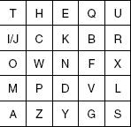
Solution:
Step 1: Use the key to construct the 5x5 Matrix
Key: The quick brown fox jumped over the lazy dogs
The quick brown fox jumped over the lazy dogs
Step 2: Rearrange the message (AMBASSADOR SHOT) into 2 letter-blocks
AMBASSADOR SHOT
AM BA SS AD OR SH OT
AM BA SS AD OR SH OT
AM BA SX SA DO RS HO T
AM BA SX SA DO RS HO T
AM BA SX SA DO RS HO TX

Slide 34
Solution; cont.:
Step 3: Encrypt the blocks
A and M fall in Same column; then A will be replaced by T and M by A
Block 1
AM BA SX SA DO RS HO TX
TA BA SX SA DO RS HO TX
Block 2
B and A are in different rows and different columns; then B will be replaced by I and A by G
AM BA SX SA DO RS HO TX
TA IG SX SA DO RS HO TX
Block 3
S and X fall in Same column; then S will be replaced by U and X by L
AM BA SX SA DO RS HO TX
TA IG UL SA DO RS HO TX

Slide 35
Solution; cont.:
Step 3: Encrypt the blocks
S and A fall in same row; then A will be replaced by A and M by Z
Block 4
AM BA SX SA DO RS HO TX
TA IG UL AZ DO RS HO TX
Block 5
D and O are in different rows and different columns; then D will be replaced by M and O by N
AM BA SX SA DO RS HO TX
TA IG UL AZ MN RS HO TX
Block 6
R and S fall in Same column; then R will be replaced by X and X by U
AM BA SX SA DO RS HO TX
TA IG UL AZ MN XU HO TX

Slide 36
Solution; cont.:
Step 3: Encrypt the blocks
H and O are in different rows and different columns; then H will be replaced by T and O by W
Block 7
AM BA SX SA DO RS HO TX
TA IG UL AZ MN XU TW TX
Block 8
T and X are in different rows and different columns; then T will be replaced by U and X by O
AM BA SX SA DO RS HO TX
TA IG UL AZ MN XU TW UO
Finally
AM BA SX SA DO RS HO TX
TA IG UL AZ MN XU TW UO

